Slide 1
An Introduction to Industrial and Organizational (IO) Psychology
Chapter 1

Slide 2
Overview
Module 1.1 – The Importance of IO Psychology
Module 1.2 – The Past, Present, and Future of IO Psychology
A Brief History of IO Psychology
Modern IO Psychology

Slide 3
Module 1.1 – The Importance of IO Psychology

Slide 4
Importance of Work
Importance of work in people’s lives
We spend a large percentage of our lives working!
The “lottery question”
If you were to get enough money to live as comfortably as you would like for the rest of your life, would you continue to work or would you stop working?
Why do we work?
Money
Social status
Achievement and self-realization
Self-definition
Social contacts
Challenges
Taking initiative/responsibility

Slide 5
So What Is IO Psychology?
Industrial/Personnel psychology
Focused on improving concrete organizational outcomes (usually job performance)
Organizational psychology
Focused on the social, emotional, and motivational side of work and improving individual outcomes

Slide 6
What Is IO Psychology?
______________________________
______________________________
Selection/Assessment
Placement
Job Analysis
Performance Appraisal
CWBs/OCBs
Training
Development
The Law
Motivation
Job Attitudes
Organizational Justice
Organizational Culture/Climate
Leadership
Emotion
Teamwork and Groups
Stress and Health

Slide 7
What Is (NOT) IO Psychology?
Human Factors Psychology/Engineering
The Business Counterparts
Human Resources
Organizational Behavior

Slide 8
The Scientist-Practitioner Model
The _______________: Using scientifically supported principles of research to ask questions about psychology at work
The _______________: Using the Scientist’s research to improve individual and organizational outcomes for real organizations

Slide 9
IO Psychology’s contributions to society
Building sustainable and environmentally conscious organizations
Humanitarian work psychology (HWP): application of I-O psychology to humanitarian arena, especially poverty reduction and promotion of decent work, aligned with local stakeholders’ needs, and in partnership with global aid/development groups
The aging workforce
Multicultural and multinational work

Slide 10
IO Psychology is an Evidence-Based Approach
“Evidence-based management means managerial decisions & org practices are informed by the best available scientific evidence”
(Rousseau & McCarthy, 2007)

Slide 11
SIOP as a Resource
Society for Industrial and Organizational Psychology (SIOP; Division 14 of APA)
Established in 1945
More than 9,600 members
www.siop.org
History of IO psychology
Membership information (incl. students)
Quarterly newspaper: TIP
JobNet
Educational institutions that offer graduate training programs in I-O psychology
List of SIOP publications

Slide 12
How This Course Can Help You
Knowledge about 21st century workplace
Help you understand your work experiences
Provide a foundation for developing and/or implementing effective work-related policies
Allow you to help others understand how work policies are affecting them
Course will address issues such as work stress, work-family balance, workplace discrimination, & leadership

Slide 13
Module 1.2 – past, present, & Future of IO Psychology
1 | 2 | 3 | 4 | 5 | 6 | 7 | 8 | 9 | 10 | 11 | 12 | 13 | 14 | 15 | 16 | 17 | 18 | 19 | 20
21 | 22 | 23 | 24 | 25 | 26 | 27 | 28 | 29 | 30 | 31 | 32 | 33 | 34 | 35 | 36 | 37 | 38 | 39 | 40
41 | 42 | 43 | 44 | 45 | 46 | 47 | 48 | 49 | 50 | 51 | 52 | 53 | 54 | 55 | 56 | 57 | 58 | 59 | 60
61 | 62 | 63 | 64 | 65 | 66 | 67 | 68 | 69 | 70 | 71 | 72 | 73 | 74 | 75 | 76 | 77 | 78 | 79 | 80

Slide 14
The Eras of IO Psychology
Era 1: Infancy
Late 19th century (1876) through the aftermath of World War I (1930s)
Era 2: Change in Focus
1930s through WW2
Era 3: Rapid Growth
WW2 through 1960s
Era 4: The Cognitive Revolution
1960s to present

Slide 15
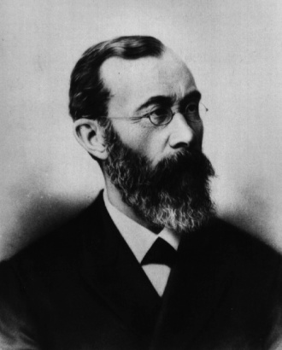
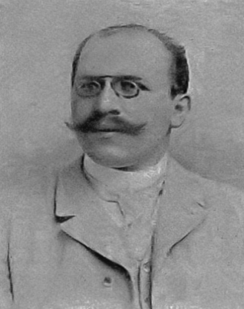
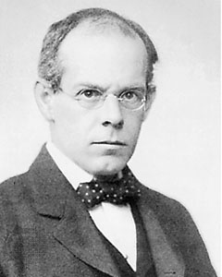
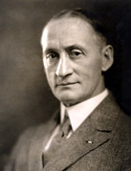
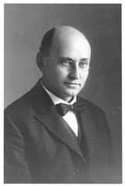
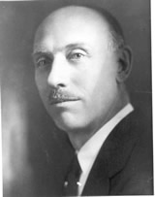
Era 1: Infancy
A new science
Wilhelm Wundt
Developing IO
Hugo Munsterberg
James Cattell
Harry Hollingworth
World War I
Walter Dill Scott and Walter Bingham

Slide 16
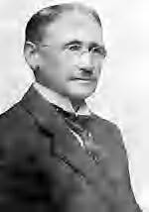
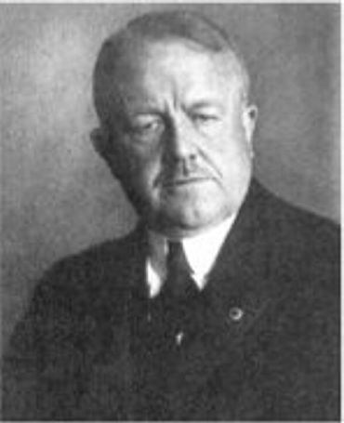
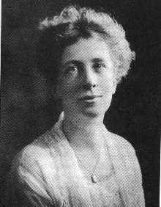
Era 1: Infancy
Time and Motion Studies
Frederick Taylor
Frank and Lilian Gilbreth
Lilian Gilbreth was awarded the first Ph.D. in Industrial Psychology in 1917
Beginning of the Journal of Applied Psychology

Slide 17
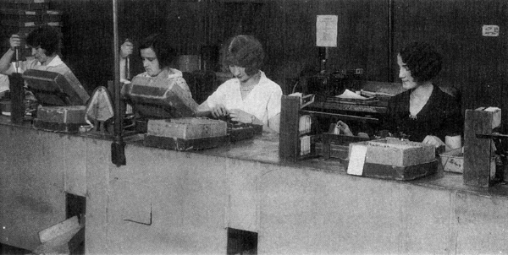
Era 2: Change in Focus
Elton Mayo’s Hawthorne Studies

Slide 18

Era 2: Change in Focus
Military Involvement
Henry Murray at the Office of Strategic Services (OSS)
If you worked for the OSS, how would you test to see if someone was mentally stable enough to spy on the Nazis?

Slide 19
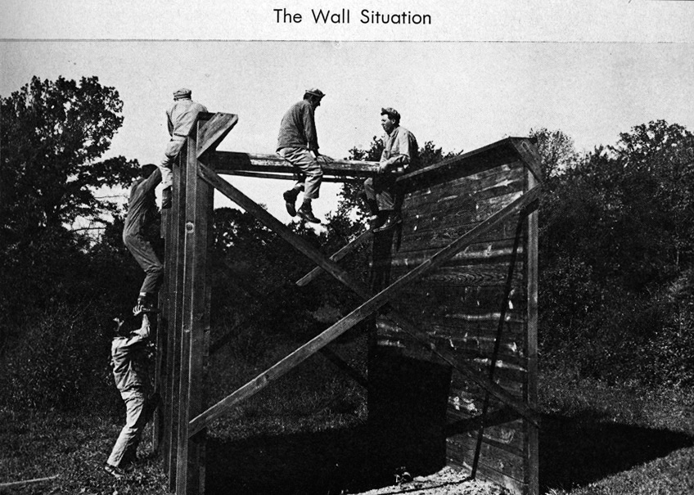
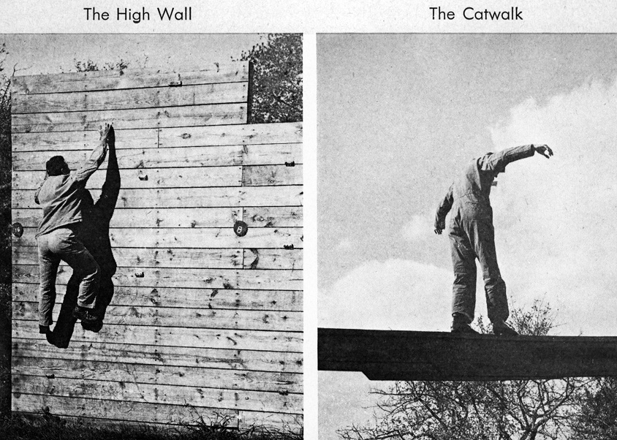
OSS Selection Procedures

Slide 20
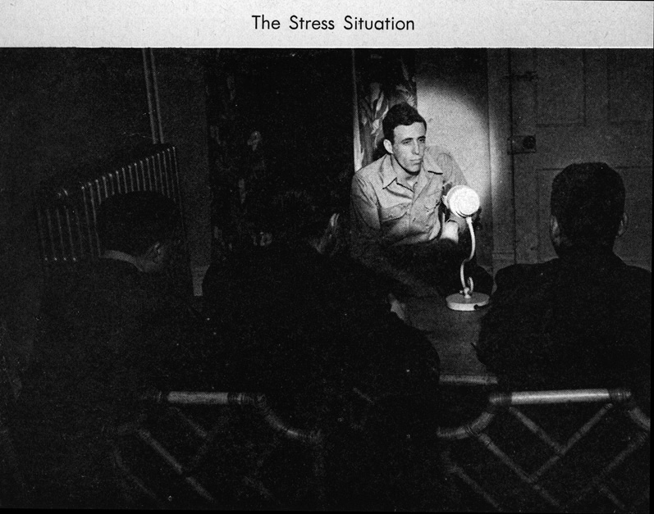
OSS Selection Procedures

Slide 21

OSS Selection Procedures

Slide 22
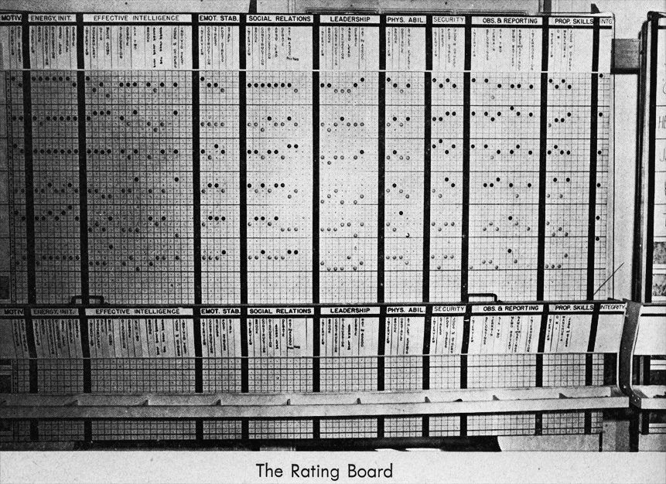
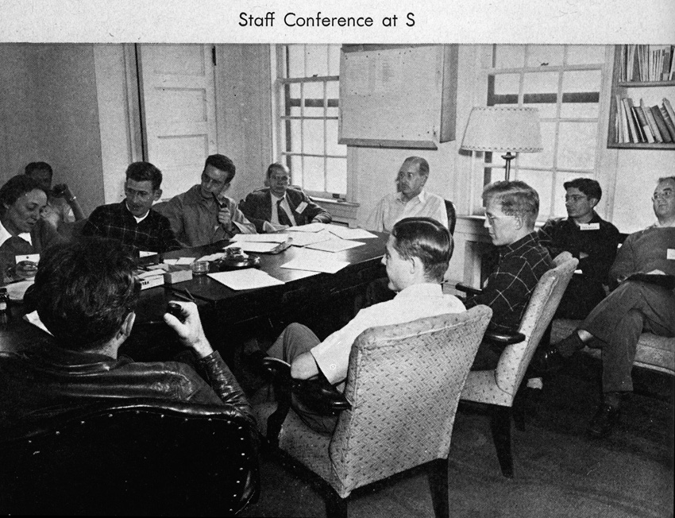
OSS Selection Procedures

Slide 23
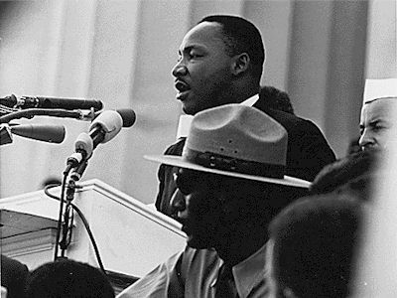
Era 3: Rapid Growth
Post-War Boom
The Civil Rights Movement
Title VII of the Civil Rights Act of 1964
Explosion of Ph.D.-level training

Slide 24
Civil Rights Act of 1964 & Title VII
Title VII specified demographic groups to be protected from employment discrimination
Groups named in 1964
2 additional protected groups added later
ADEA (age) 1967
ADA (disability) 1990

Slide 25
Era 4: The Cognitive Revolution
Looking inside “The Black Box”
Behaviorism fades into the mists
Increased focus on globalization
Responding to economic forces
New organizational structures
The merits and pitfalls of diversity
Validity generalization
Workplace stress, aggression, violence
Workplace
Interventions
???
PROFIT!!!

Slide 26
The Present: Demographics of IO Psychologists
In 2012, IO psychologists represented about 4% of all APA members
In 2015, ~49% of IO psychologists in SIOP were women
2015 Median salaries:
Ph.D. in IO psychology: $118,818
Masters in IO psychology: $84,500
Notes:
%female based on responses to salary survey.

Slide 27
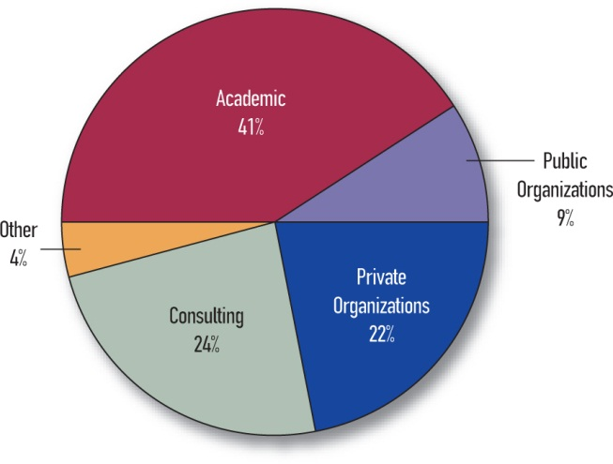
Where IO Psychologists are Employed

Slide 28
Changes in the Workplace Since 1980
Personal computing
Telecommuting & virtual teams
Videoconferencing
Providing a service vs. manufacturing “goods”
Nature of work more fluid
Teams vs. the individual
Little stability
Family-friendly workplaces
Greater diversity
Global workplace

Slide 29
Challenges to IO in the 21st Century
IO psychology needs to:
Be relevant – need to study the problems of today, not those of yesterday
Be useful – put research into practice
Think bigger – tackle larger, societal issues (e.g., unemployment, globalization, etc.)
Be grounded in scientific method – careful and systematic observation, development of hypotheses that can be tested, collection and analysis of data, and logical connection between data and interpretations

